Slide 1

Auto-navigation of mathematical modeled quadcopter using deep learning
Arjun Vijayanatha Kurup
Supervised by,
Johan Thunberg

Slide 2
Objective of the project
Implement a mathematical model based on dynamics, kinematics
Implement a stabilization controller (PID controller).
Predict the trajectory planning using Deep learning and neural network algorithm(Alexnet).

Slide 3
Problem formulation
Lack of controller implementation based on deep learning.
Typical use of classical controller such as PID and PD are already implemented.
Lack of accuracy when using a classical controller.
Make prediction based on the data acquired from the quadcopter.
The challenge is that the quadcopter has six degrees of freedom but there are only four control inputs

Slide 4
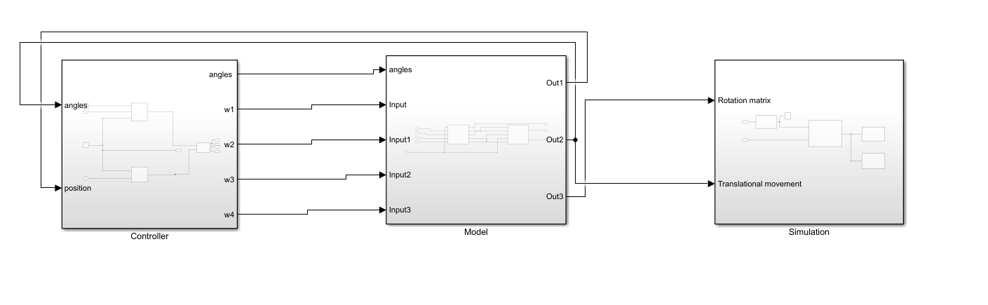
Advantages of the project
Able to develop an automated quadcopter using deep learning
Predict the trajectory
Avoid obstacles
Stabilization of the quadcopter
Other controllers can be tested on the model

Slide 5
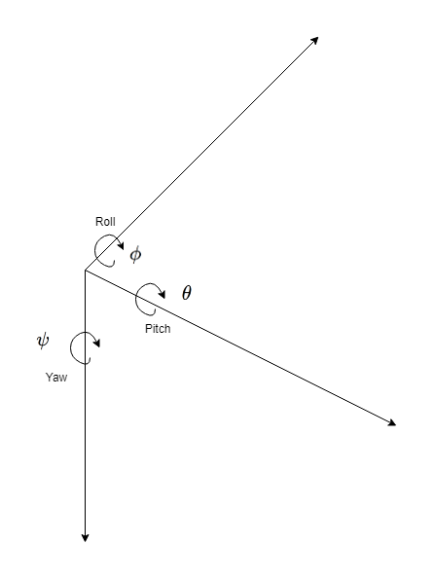
Mathematical Model
Quadcopter
Position (x, y, z)
Roll, Pitch, Yaw (ᶲ ᶿ ᵠ)
Pose
Body Frame
Linear Velocity
Angular velocity
Inertial Frame - Fixed to earth
Rotation matrix
Goes from inertial – to – body frame
Transformation matrices
Inertial – to – body.
Body – to – inertial.

Slide 6
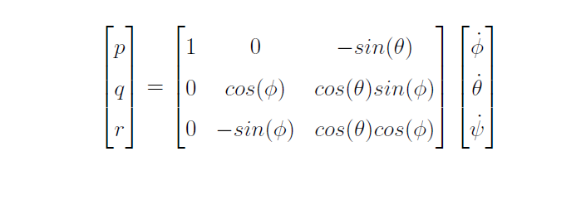

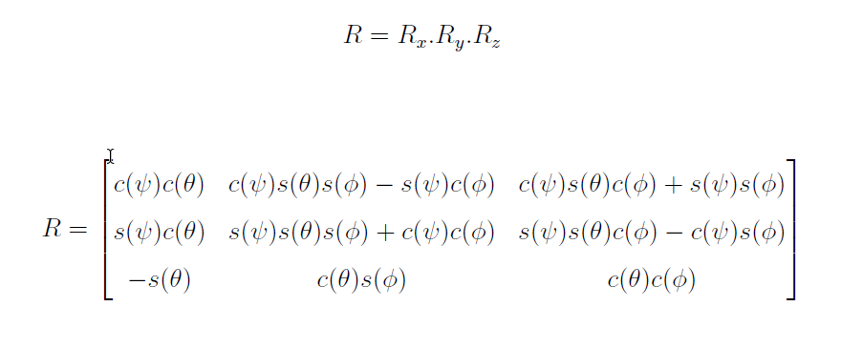
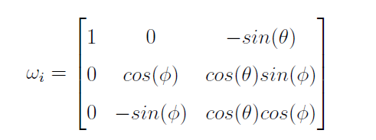
Equations
Angular velocity in the inertial frame
Angular acceleration in the inertial frame
Rotation matrix in the inertial frame
Angular velocity of actuators

Slide 7
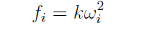
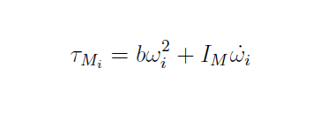
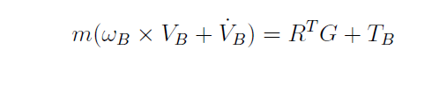
Mathematical Model
Roll
-2nd rotor, +4th rotor
Pitch
-1st rotor, +3rd rotor
Yaw
+/-(+1st, +3rd, -2nd, -4th)
Newton Euler Equation
Grouping together of newtons two laws of motion
Relate the motion of center of gravity of a rigid body
Sum of forces and torques acting on the rigid body
Describe the combined translation and rotational dynamics of a rigid body

Slide 8
Controller
For Stabilization
PID Controller
Classical type
Uses Proportional, Integral, Derivative gains for calculating the error
Uses a feedback mechanism

Slide 9
Learning based controller
Alexnet
Trajectory planning and control methodology
Pretrained deep learning convolutional neural network
Trained using ImageNet image data set
Accurate prediction and reduced error rate

Slide 10
Simulation
Using Matlab and Simulink Blocks
Aerospace blockset used for altitude, wind, trajectory estimation
3D-Animation Toolbox used for VRML 3d animation and CAD input
Visualization Blocks used for Realtime visualization
Alexnet is also included
Parameters used:

Slide 11
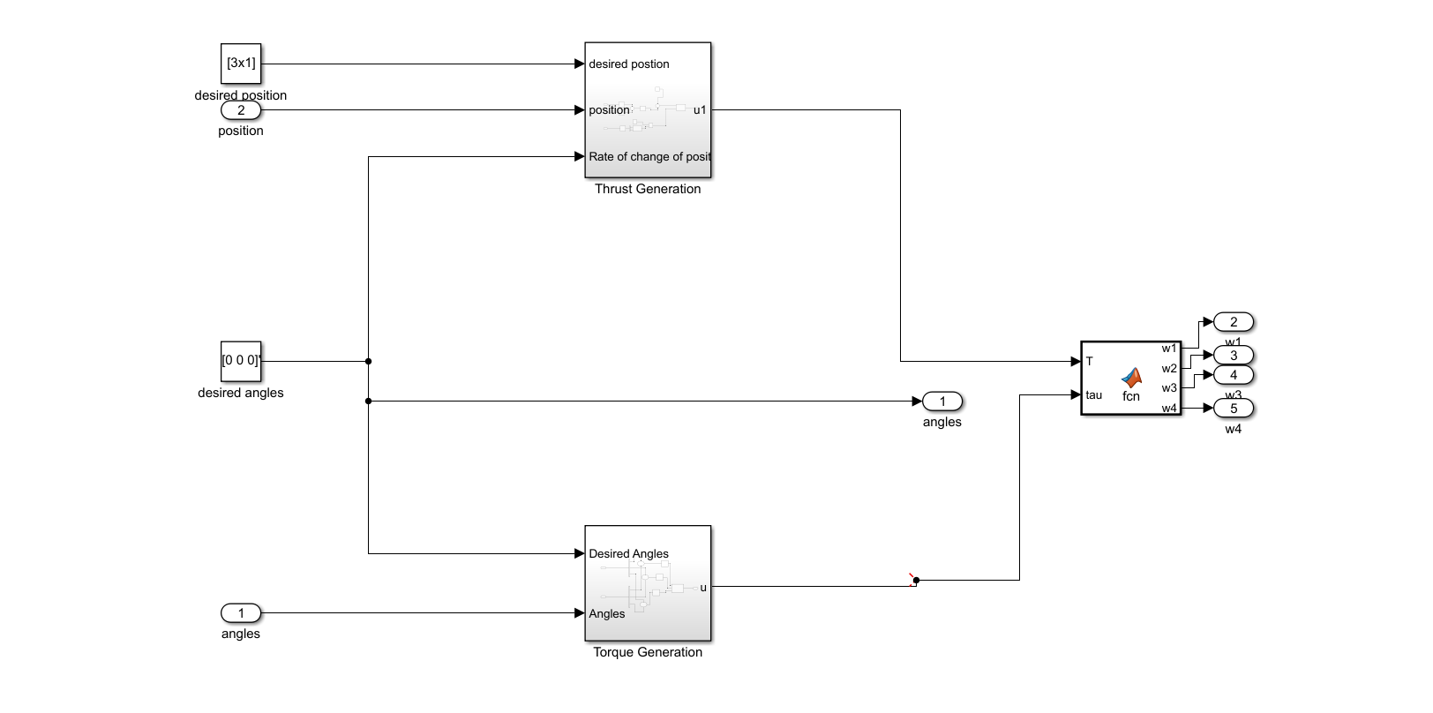
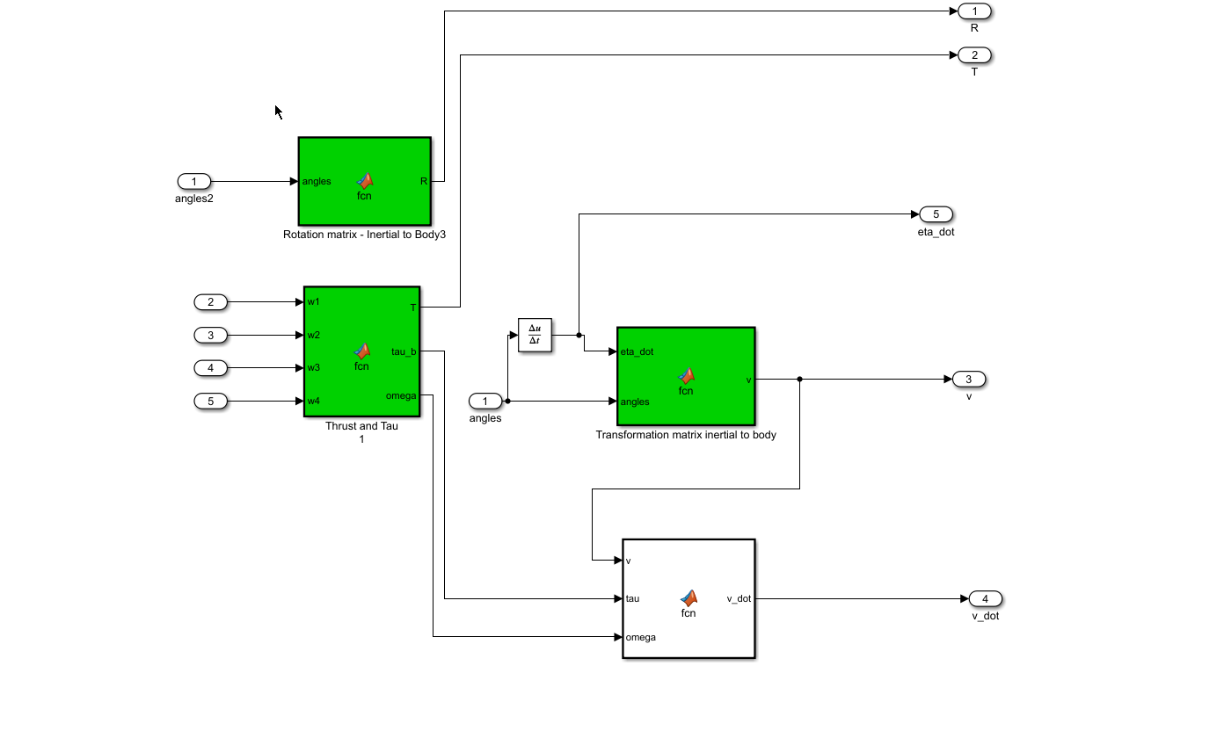
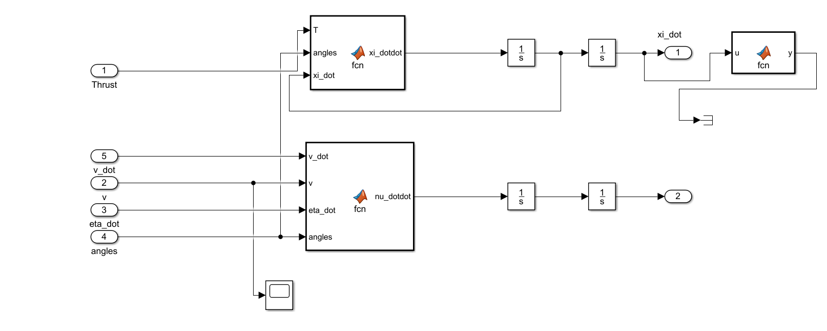
Simulink Blocks
Controller Block
Simulation Block
Euler equations Block
Rotation equations Block

Slide 12
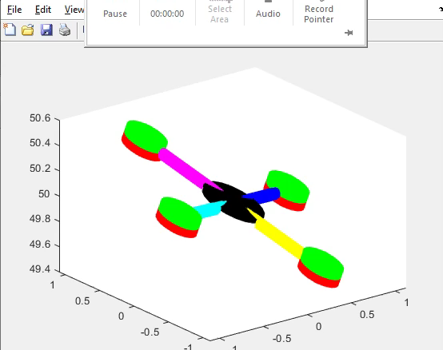
Results
Rising to a certain altitude
Stabilizing
Calculated using the mathematical equations.

Slide 13
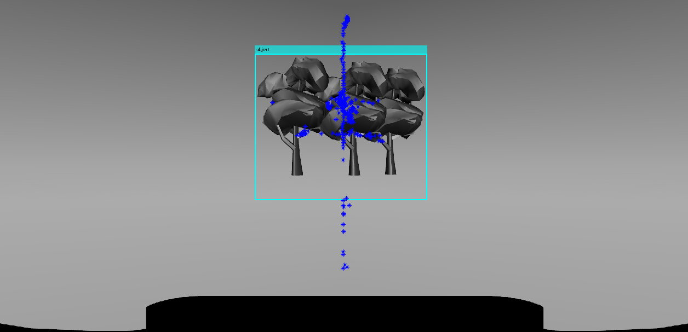
Result
Image showing the obstacle detection and avoidance.
The trajectory is estimated using the external points calculated from the centroid
Any point outside the Bounding box will be the trajectory point.

Slide 14
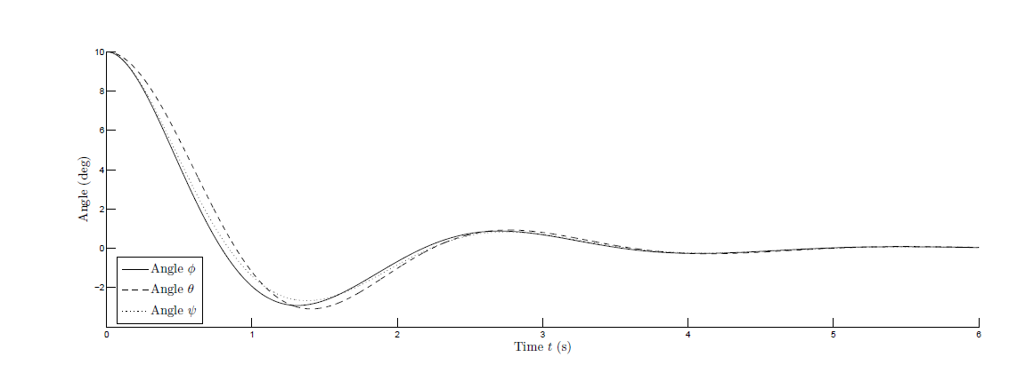
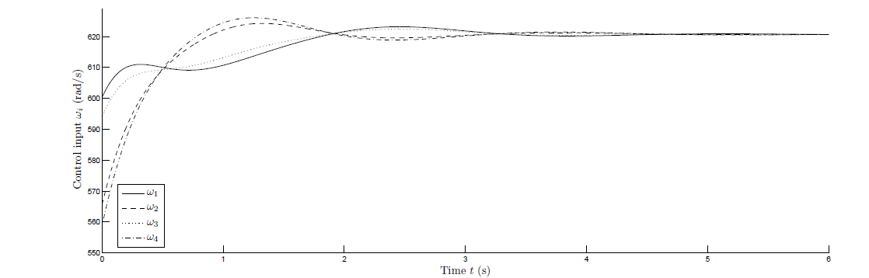
Controller Result

Slide 15

Thank You

